Slide 1
Quantitative Chemistry

Slide 2
Contents
Quantitative Chemistry
Chemical symbols and formulae
Representing reactions
Mass and percentage composition
Empirical formulae
Reacting masses
Summary activities

Slide 3
Elements and chemical symbols
Each element has a symbol.
Many you can predict from the name of the element.
And some you can’t!
Name
Atom
Symbol
Name
Atom
Symbol
Hydrogen
H
H
Sodium
Na
Na
Oxygen
O
O
Copper
Cu
Cu
Silver
Ag
Ag
Nitrogen
N
N
Lead
Pb
Pb
Phosphorus
P
P

Slide 4
Elements and chemical formulae
Each element has a symbol.
Some elements exist as particular numbers of atoms bonded together.
This fact can be represented in a formula with a number which shows how many atoms.
Atom
Molecule
Formula
O
O
O
O₂
N
N
N
N₂
H
H
H
H₂
P
P
P
P
P₄
P

Slide 5
Formulae of molecular compounds
Molecular compounds have formulae that show the type and number of atoms that they are made up from.
Name
Formula
Methane
H
H
C
H
CH₄
H
Carbon dioxide
CO₂
O
C
O
Water
H
H₂O
O
H

Slide 6
Formulae of ionic compounds
Ionic compounds are giant structures.
There can be any number of ions in an ionic crystal - but always a definite ratio of ions.
+
-
+
-
+
-
-
+
-
+
+
+
-
-
-
+
+
-
+
-
-
+
+
+
-
-
+
Sodium chloride
A 1:1 ratio
Name | Ratio | Formula
Sodium chloride | 1:1
Magnesium chloride | 1:2
Aluminium chloride | 1:3
Aluminium Oxide | 2:3
NaCl
MgCl₂
AlCl₃
Al₂O₃

Slide 7
Compound ions
Some ions are single atoms with a charge.
Chloride Cl⁻
nitride N³⁻
Sulphide S²⁻
Cl⁻
nitrate
NO₃⁻
Sulphate
SO₄²⁻
O
N
O⁻
N³⁻
O
O
S²⁻
O⁻
S
O⁻
O
Other ions consist of groups of atoms that remain intact throughout most chemical reactions. These are called compound ions.
E.g. Nitrate and sulphate ions commonly occur in many chemical reactions.

Slide 8
Charges on ions
Many elements form ions with some definite charge (E.g. Na⁺, Mg²⁺ and O^{2-).} It is often possible to work out the charge using the Periodic Table.
If we know the charges on the ions that make up the compound then we can work out its formula.
This topic is covered in more detail in the Topic on Bonding but a few slides are included here on how to work out the charges on ions and use these to deduce the formula of simple ionic compounds.

Slide 9
Charges and metal ions
Metals usually lose electrons to empty this outer shell.
The number of electrons in the outer shell is usually equal to the group number in the Periodic Table.
Eg. Li =Group 1 Mg=Group2 Al=Group3
Mg
Al
Li
2.1⇨Li⁺
2.8.2 ⇨ Mg²⁺
2.8.3 ⇨
Al³⁺

Slide 10
Charges for non-metal ions
Elements in Groups 4 onwards generally gain electrons and the number of electrons they gain is equal to the Group Number.
Oxygen (Group 6) gains (8-6) =2 electrons to form O²⁻
Chlorine (Group 7) gains (8-7)=1 electron to form Cl⁻
O
Cl
2.6⇨2.8 O ⇨ O²⁻
2.8.7⇨ 2.8.8 Cl ⇨ Cl⁻

Slide 11
What’s the charge?
Copy out and fill in the Table below showing what charge ions will be formed from the elements listed.
1
2
3
4
5
6
7
0
H
He
Li
Be
B
C
C
N
O
F
Ne
Na
Mg
Al
Si
P
S
Cl
Mg
Cl
Ar
K
K
Ca
Sc
Ti
V
Cr
Mn
Fe
Co
Ni
Cu
Zn
Ga
Ge
As
Se
Br
Kr
Symbol | Li | N | Cl | Ca | K | Al | O | Br | Na
Group No
Charge
1
5
7
2
1
3
6
7
1
1+
3-
1-
2+
1+
3+
2-
1-
1+

Slide 12
Calcium bromide
This is most quickly done in 5 stages.
Remember the total + and – charges must =zero
Eg. The formula of calcium bromide.
Symbols: Ca Br
Charge on ions 2+ 1-
Need more of Br
Ratio of ions 1 2
Formula CaBr₂
Br
Br⁻
Ca
Ca²⁺
Br⁻
Br
2 electrons

Slide 13
Aluminium bromide
Eg. The formula of aluminium bromide.
Symbols: Al Br
Charge on ions 3+ 1-
Need more of Br
Ratio of ions 1 3
Formula AlBr₃
Br
Br⁻
Al
Br
Al³⁺
Br⁻
Br
Br⁻
3 electrons

Slide 14
Aluminium oxide
Eg. The formula of aluminium oxide.
Symbols: Al O
Charge on ions 3+ 2-
Need more of O
Ratio of ions 2 3 (to give 6 e⁻)
Formula Al₂O₃
2e⁻
O
O²⁻
Al
Al³⁺
2e⁻
O
O²⁻
Al
Al³⁺
O
O²⁻
2e⁻

Slide 15
Magnesium chloride
Eg. The formula of magnesium chloride.
Symbols: Mg Cl
Charge on ions
Need more of
Ratio of ions
Formula
2+
1-
Cl
1:2
MgCl₂
1e⁻
Cl⁻
Cl
Mg
Mg²⁺
Cl⁻
Cl
1e⁻

Slide 16
Sodium oxide
Eg. The formula of sodium oxide.
Symbols: Na O
Charge on ions
Need more of
Ratio of ions
Formula
1+
2+
Na
2 : 1
Na₂O
Na
1e⁻
Na⁺
O
O²⁻
Na
Na⁺
1e⁻

Slide 17
Brackets and compound ions
Ions like nitrate and sulphate remain unchanged throughout many reactions.
Because of this we tend to think of the sulphate ion as a “group” rather than a “collection of individual” sulphur and oxygen atoms.
This affects how we write formulae containing them. Aluminium sulphate contains two Al ions and three sulphate ions.
We write it as Al₂(SO₄)₃
Not Al₂S₃O₁₂
Similar rules apply to ions such as nitrate NO₃⁻, hydroxide OH⁻, etc.

Slide 18
Calculate the compounds
Using the method shown on the last few slides, work out the formula of all the ionic compounds that you can make from combinations of the metals and non-metals shown below:
Metals: Li Ca Na Mg Al K
Non-Metals: F O N Br S Cl

Slide 19
What’s the formula?
Use the information to write out the formula for the compound.
1) Calcium bromide
(One calcium ion, two bromide ions)
2) Ethane
(Two carbon atoms, six hydrogen atoms)
3) Sodium oxide
(Two sodium ions, one oxygen ion)
4) Magnesium hydroxide
(One magnesium ion, two hydroxide ions)
5) Calcium nitrate
(One calcium ion, two nitrate ions)
CaBr₂
C₂H₆
Na₂O
Mg(OH)₂
Ca(NO₃)₂

Slide 20
Contents
Representing reactions

Slide 21
Reactants and products
All equations take the general form:
Reactants ➔ Products
Word equations simply replace “reactants and products” with the names of the actual reactants and products. E.g.
Reactants |  | Products
Magnesium + oxygen | ➔
Sodium + water | ➔
Magnesium + lead nitrate | ➔
Nitric acid + calcium hydroxide | ➔
Magnesium oxide
Sodium hydroxide + hydrogen
Magnesium nitrate + lead
Water + calcium nitrate

Slide 22
Word equations
Write the word equations for the descriptions below.
The copper oxide was added to hot sulphuric acid and it reacted to give a blue solution of copper sulphate and water.
Copper oxide
+
sulphuric acid
➔
copper sulphate
+
water
The magnesium was added to hot sulphuric acid and it reacted to give colourless magnesium sulphate solution plus hydrogen
Magnesium
+
sulphuric acid
➔
Magnesium sulphate
+
hydrogen

Slide 23
More word equations
Write the word equations for the descriptions below.
The methane burned in oxygen and it reacted to give carbon dioxide and water.
methane
+
oxygen
➔
Carbon dioxide
+
water
The copper metal was placed in the silver nitrate solution. The copper slowly disappeared forming blue copper nitrate solution and needles of silver metal seemed to grow from the surface of the copper
copper
+
Silver nitrate
➔
Copper nitrate
+
silver

Slide 24
Chemical formulae equations
Step 1: Write down the word equation.
Step 2: Replace words with the chemical formula .
Step 3: Check that there are equal numbers of each type of atom on both sides of the equation. If not, then balance the equation by using more than one.
Step 4: Write in the state symbols (s), (l), (g), (aq).
Reactants
Products
magnesium + oxygen
➔
magnesium oxide
Mg + O₂
➔
MgO
Oxygen doesn’t balance.Need 2 MgO and so need 2 Mg
2Mg + O₂
➔
2MgO
2Mg(s) +O₂(g)
➔
2MgO(s)

Slide 25
Sodium + water
Step 1: Write down the word equation.
Step 2: Replace words with the chemical formula .
Step 3: Check that there are equal numbers of each type of atom on both sides of the equation. If not, then balance the equation by using more than one.
Step 4: Write in the state symbols (s), (l), (g), (aq).
Reactants |  | Products
sodium + water | ➔ | hydrogen + sodium hydroxide
+ | ➔ | +
+ | ➔ | +
+ | ➔ | +
Na
H₂O
H₂
NaOH
Hydrogen doesn’t balance.
Use 2 H₂O, NaOH, 2Na
2Na
2H₂O
H₂
2NaOH
2Na(s)
2H₂O(l)
H₂(g)
2NaOH(aq)

Slide 26
Magnesium + lead nitrate
Step 1: Write down the word equation.
Step 2: Replace words with the chemical formula .
Step 3: Check that there are equal numbers of each type of atom on both sides of the equation. If not, then balance the equation by using more than one.
Step 4: Write in the state symbols (s), (l), (g), (aq).
Reactants |  |  | Products
magnesium + lead nitrate | ➔ |  | magnesium nitrate + lead
+ | ➔ |  | +
+ | ➔ | +
Mg
Pb(NO₃)₂
Mg(NO₃)₂
Pb
Already balances.
Just add state symbols
Mg(s)
Pb(NO₃)₂(aq)
Mg(NO₃)₂(aq)
Pb(s)

Slide 27
Balance the equations
Below are some chemical equations where the formulae are correct but the balancing step has not been done. Write in appropriate coefficients (numbers) to make them balance.
Reactants |  | Products
AgNO₃(aq) + CaCl₂(aq) | ➔ | Ca(NO₃)₂(aq) + AgCl(s)
CH₄(g) + O₂(g) | ➔ | CO₂(g) + H₂O(g)
Mg(s) + Ag₂O(s) | ➔ | MgO(s) + Ag(s)
NaOH + H₂SO₄(aq) | ➔ | Na₂SO₄(aq) + H₂O(l)
2
2
2
2
2
2
2

Slide 28
Contents
Mass and percentage composition

Slide 29
Relative atomic mass
The atoms of each element have a different mass.
Carbon is given a relative atomic mass (RAM) of 12.
The RAM of other atoms compares them with carbon.
Eg. Hydrogen has a mass of only one twelfth that of carbon and so has a RAM of 1.
Below are the RAMs of some other elements.
Element | Symbol | Times as heavy as carbon | R.A.M
Helium | He | One third
Beryllium | Be | Three quarters
Molybdenum | Mo | Eight
Krypton | Kr | Seven
Oxygen | O | One and one third
Silver | Ag | Nine
Calcium | Ca | Three and one third
4
12
96
84
16
108
40

Slide 30
Formula mass
For a number of reasons it is useful to use something called the formula mass.
To calculate this we simply add together the atomic masses of all the atoms shown in the formula. (N=14; H=1; Na=23; O=16; Mg=24; Ca=40)
Substance | Formula | Formula Mass
Ammonia | NH₃
Sodium oxide | Na₂O
Magnesium hydroxide | Mg(OH)₂
Calcium nitrate | Ca(NO₃)₂
14 + (3x1)=17
(2x23) + 16 =62
24+ 2(16+1)=58
40+ 2(14+(3x16))=164

Slide 31
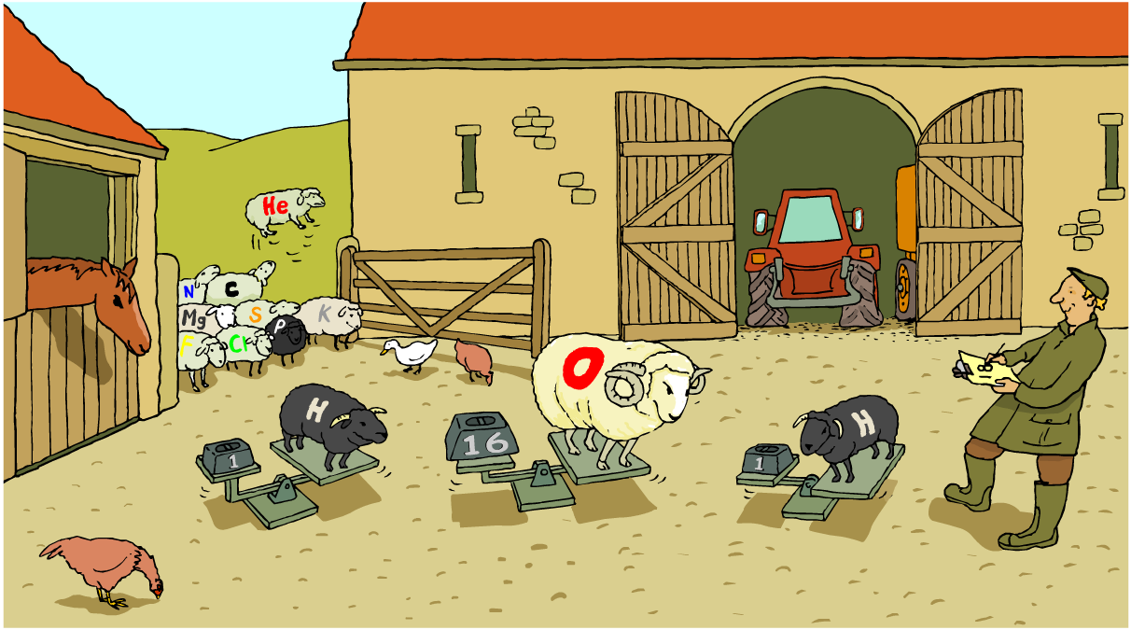
RAM and formula mass
How is formula mass calculated?

Slide 32
Percentage composition
It is sometimes useful to know how much of a compound is made up of some particular element.
This is called the percentage composition by mass.
% Z = (Number of atoms of Z) x (atomic Mass of Z) Formula Mass of the compound
E.g. % of oxygen in carbon dioxide (Atomic Masses: C=12. O=16) Formula = Number oxygen atoms = Atomic Mass of O = 16 Formula Mass CO₂ =
% oxygen =
CO₂
2
12 +(2x16)=44
2 x 16 / 44 = 72.7%

Slide 33
How much oxygen?
Calculate the percentage of oxygen in the compounds shown below
% Z = (Number of atoms of Z) x (atomic Mass of Z) Formula Mass of the compound
Formula | Atoms of O | Mass of O | Formula Mass | %age Oxygen
MgO | 1
K₂O | 1
NaOH | 1
SO₂ | 2
16
24+16=40
16x100/40=40%
16
(2x39)+16 =94
16x100/94=17%
16
23+16+1=40
16x100/40=40%
32
32+(2x16)=64
32x100/64=50%

Slide 34
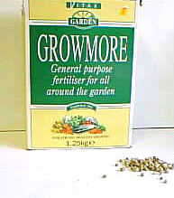
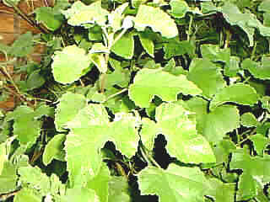
Which fertilizer?
Nitrogen is a vital ingredient of fertiliser that is needed for healthy leaf growth.
But which of the two fertilisers ammonium nitrate or urea contains most nitrogen?
To answer this we need to calculate what percentage of nitrogen is in each compound

Slide 35
How much nitrogen?
Formulae: Ammonium Nitrate NH₄NO₃: Urea CON₂H₄
Formula | Atoms of N | Mass of N | Formula Mass | %age Nitrogen
NH₄NO₃ | 2 | 28
CON₂H₄ | 2 | 28
14+(1x4)+14+(3x16)=80
28x100 /80 = 35%
12+16+(2x14+(4x1)=
60
28x100 /60 = 46.7%
Atomic masses H=1: C=12: N=14: O=16
And so, in terms of % nitrogen urea is a better fertiliser than ammonium nitrate

Slide 36
Contents
Empirical formulae

Slide 37
Calculating the formula from masses
When a new compound is discovered we have to deduce its formula.
This always involves getting data about the masses of elements that are combined together.
What we have to do is work back from this data to calculate the number of atoms of each element and then calculate the ratio.
In order to do this we divide the mass of each atom by its atomic mass.
The calculation is best done in 5 stages:

Slide 38
Copper oxide
We found 3.2g of copper reacted with 0.8g of oxygen. What is the formula of the oxide of copper that was formed? (At. Mass Cu=64: O=16)
Substance | Copper oxide
1. Elements | Cu | O
2. Mass of each element (g)
3. Mass / Atomic Mass
4. Ratio
5. Formula
3.2
0.8
3.2/64 =0.05
0.8/16 =0.05
1:1
CuO

Slide 39
Manganese oxide
We found 5.5g of manganese reacted with 3.2g of oxygen. What is the formula of the oxide of manganese formed? (Atomic. Mass Mn=55: O=16)
Substance | Manganese oxide
1. Elements | Mn | O
2. Mass of each element (g)
3. Mass / Atomic Mass
4. Ratio
5. Formula
5.5
3.2
5.5/55 =0.10
3.2/16 =0.20
1:2
MnO₂

Slide 40
Silicon chloride
A chloride of silicon was found to have the following % composition by mass: Silicon 16.5%: Chlorine 83.5%
(Atomic. Mass Si=28: Cl=35.5)
Substance | Silicon Chloride
1. Elements | Si | Cl
2. Mass of each element (g per 100g)
3. Mass / Atomic Mass
4. Ratio
5. Formula
16.5
83.5
16.5/28 =0.59
83.5/35.5 =2.35
Cl÷Si = (2.35 ÷ 0.59) = (3.98)
Ratio of Cl:Si =4:1
Divide biggest by smallest
SiCl₄

Slide 41
Calculate the empirical formulae
Calculate the formula of the compounds formed when the following masses of elements react completely:
(Atomic. Mass Si=28: Cl=35.5)
Element 1 | Element 2 | Atomic Masses | Formula
Fe = 5.6g | Cl=106.5g | Fe=56 Cl=35.5
K = 0.78g | Br=1.6g | K=39: Br=80
P=1.55g | Cl=8.8g | P=31: Cl=35.5
C=0.6g | H=0.2g | C=12: H=1
Mg=4.8g | O=3.2g | Mg=24: O=16
FeCl₃
KBr
PCl₅
CH₄
MgO

Slide 42
Contents
Reacting masses

Slide 43
Conservation of mass
New substances are made during chemical reactions.
However, the same atoms are present before and after reaction. They have just joined up in different ways.
Because of this the total mass of reactants is always equal to the total mass of products.
This idea is known as the Law of Conservation of Mass.
Reaction
but no
mass change

Slide 44
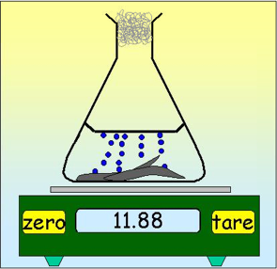

More on conservation of mass
There are examples where the mass may seem to change during a reaction.
Eg. In reactions where a gas is given off the mass of the chemicals in the flask will decrease because gas atoms will leave the flask. If we carry the same reaction in a strong sealed container the mass is unchanged.
Gas given off.
Mass of chemicals in flask decreases
HCl
Mg
Same reaction in sealed container:
No change in mass
11.71

Slide 45
Reacting mass and formula mass
The formula mass in grams of any substance contains the same number of particles. We call this amount of substance 1 mole.
Atomic Masses: H=1; Mg=24; O=16; C=12; N=14
Symbol
Formula Mass
Contains
H₂
1x2
1 mole of hydrogen molecules
MgO
24 + 16
1 mole of magnesium oxide
CH₄
12 + (1x4)
1 mole of methane molecules
HNO₃
1+14+(3x16)
1 mole of nitric acid

Slide 46
Reacting mass and equations
By using the formula masses in grams ( moles) we can deduce what masses of reactants to use and what mass of products will be formed.
Atomic masses: C=12; O=16
carbon + oxygen ➔ carbon dioxide
C + O₂ ➔ CO₂
12 + 2 x 16 ➔ 12+(2x16)
12g 32g 44g
So we need 32g of oxygen to react with 12g of carbon and 44g of carbon dioxide is formed in the reaction.

Slide 47
Aluminium + chlorine
What mass of aluminium and chlorine react together?
Atomic masses: Cl=35.5; Al=27
aluminium + chlorine ➔ aluminium chloride
2Al + 3Cl₂ ➔ 2AlCl₃
2 x 27 + 3 x 35.5 ➔ 2x (27+(3x35.5)
54g 106.5g 160.5g
So 54g of aluminium react with 106.5g of chlorine to give 160.5g of aluminium chloride.

Slide 48
Magnesium + oxygen
What mass of magnesium and oxygen react together?
Atomic masses: Mg=24; O=16
magnesium + oxygen ➔
+ ➔
+ ➔
Magnesium oxide
2
Mg
O₂
2
MgO
2 x 24
2x16
2x(24+16)
48g
32g
80g
So 48g of magnesium react with 32g of oxygen to give 80g of magnesium oxide.

Slide 49
Sodium hydroxide + hydrochloric acid
What mass of sodium chloride is formed when sodium hydroxide and hydrochloric acid react together?
Atomic masses: Na = 23 O = 16 H = 1 Cl = 35.5
Sodium + hydrochloric ➔ + hydroxide + acid
+ ➔ +
Sodium chloride
water
NaOH
HCl
NaCl
H₂O
23+1+16
1+35.5
23+35.5
(2x1)+16
40g
36.5g
58.5g
18g
So 40g of sodium hydroxide react with 36.5g of hydrochloric acid to give 58.5g of sodium chloride.

Slide 50
Avoiding mistakes!
It is important to go through the process in the correct order to avoid mistakes.
Step 1 Word Equation
Step 2 Replace words with correct formula.
Step 3 Balance the equation.
Step 4 Write in formula masses. Remember: where the equation shows more than 1 molecule to include this in the calculation.
Step 5 Add grams to the numbers.

Slide 51
Reacting mass and scale factors
We may be able to calculate that 48g of magnesium gives 80g of magnesium oxide – but can we calculate what mass of magnesium oxide we would get from burning 1000g of magnesium? There are 3 extra steps:
Step 1 | Will 1000g of Mg give more or less MgO than 48g?
Step 2 | I need to scale ? the 48g to 1000g. What scale factor does this give?
Step 3 | If 48g Mg gives 80g of MgO What mass does 1000g give?
 | Answer
more
up
1000 = 20.83 48
20.83 x 80
1667g

Slide 52
Magnesium + copper sulfate
Mg + CuSO₄ ➔ MgSO₄ + Cu
24 64+32+(4x16) 64+32+(4x16) 64
24g 160g 20g 64g What mass of copper will I get when 2 grams of magnesium is added to excess (more than enough) copper sulfate?
Step 1 | Will 2g of Mg give more or less Cu than 24g?
Step 2 | I need to scale ? the 24g to 2g. What scale factor does this give?
Step 3 | If 24g Mg gives 64g of Cu What mass does 2g give?
 | Answer
less
down
2 = 0.0833 24
0.0833 x 64
5.3

Slide 53
Decomposition of calcium carbonate
CaCO₃ ➔ CaO + CO₂
40+12+(3x16) 40+16 12+(2x16)
100g 56g 44g
What mass of calcium oxide will I get when 20 grams of limestone is decomposed?
Step 1 | Will 20g of CaCO₃ give more or less CaO than 100g?
Step 2 | I need to scale ? the 100g to 20g. What scale factor does this give?
Step 3 | If 100g CaCo₃ gives 56g of CaO What mass does 20g give?
 | Answer
less
down
20 = 0.20 100
0.20 x 56
11.2g

Slide 54
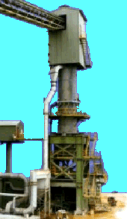
Reacting mass and industrial processes
Industrial processes use tonnes of reactants not grams.
We can still use equation and formula masses to calculate masses of reactants and products.
We simply swap grams for tonnes.
E.g. What mass of CaO does 200 tonnes of CaCO₃ give?
CaCO₃ ➔ CaO + CO₂
100 56 44
So 100 tonnes would give ? tonnes
And 200 tonnes will give
Scale factor =
So mass of CaO formed = ? tonnes =
56
more
200/100 =2
2 x 56
112 tonnes

Slide 55
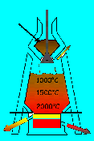
Iron (III) oxide + carbon monoxide
Iron is extracted from iron oxide Fe₂O₃
E.g. What mass of Fe does 100 tonnes of Fe₂O₃ give?
Fe₂O₃ ₊ 3CO ➔ 2Fe + 3CO₂
160 84 112 + 132
So 160 tonnes would give ? tonnes
And 100 tonnes will give
Scale factor =
So mass of Fe formed = ? =
112
less
100/160 =0.625
0.625 x 112
70 tonnes

Slide 56
Nitrogen + hydrogen
Ammonia is made from nitrogen and hydrogen
E.g. What mass of NH₃ is formed when 50 tonnes of N₂ is completely converted to ammonia?
N₂ ₊ 3H₂ ➔ 2NH₃
28 6 34
So 28 tonnes would give ? tonnes
And 50 tonnes will give than 28 tonnes
Scale factor =
So mass of NH₃ formed = ? =
34
more
50/28 =1.786
1.786 x 34
60.7 tonnes

Slide 57
Summary activities

Slide 58
Glossary
empirical formula – The simplest ratio of different atoms in a compound.
formula mass – The sum of the relative atomic masses of all the elements in a substance.
molecular formula – The actual ratio of different atoms in a molecule.
percentage composition – The amount of a given element in a substance written as a percentage of the total mass of the substance.
reacting mass – The mass of a substance that is needed to completely react with a given mass of another substance.
relative atomic mass – The mass of an element compared to the mass of ¹⁄₁₂ of the mass of carbon-12.

